Slide 1
Connecting Design and the Fight Against Climate Change: Klimavize Case Study
Transition - Design - Education, 6. 5. 2022
Notes:
Abych vám nějak zarámovala, kdo jsem:
Ahoj, jsem Tereza - designérka a výzkumnice, toho času v HoŘ - UX/service/product design
Kromě toho dělám nějaké věci bokem - design jamy, Klimavize - designový aktivismus, sem tam lektoruju na různých univerzitách
Studovala jsem v Brně na KISKu, diplomka o etice v designu

Slide 2
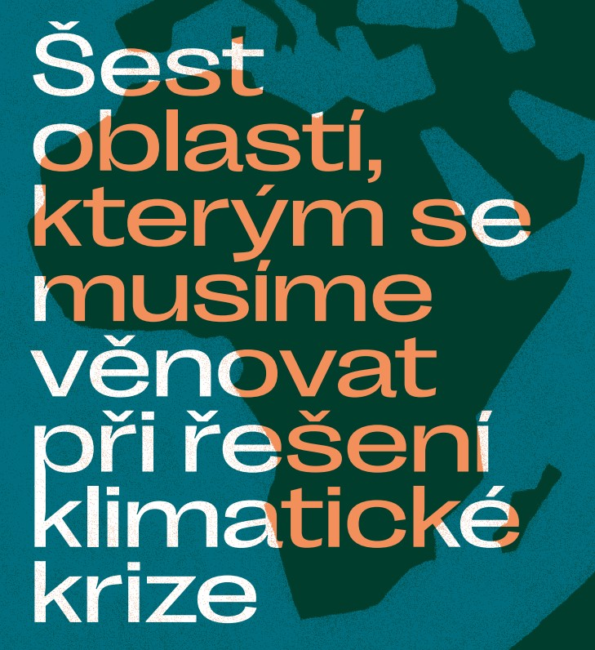
Notes:
So what is Klimavize (six areas on which we need to focus when solving the crimate crisis)? We call it “our common research which will help us find new big opportunities for the climate movement”
A collaboration between designers and people from the Czech climate movement - a team of 2 designers, 3 climate activists and one person with both backgrounds
Why did we create it?
Because in CZ in 2021, it was more or less obvious that we would step back from using coal - a date was set for 2033
So what comes next? The movement needed inputs on what to do, and there was a big gap in continuity because of the pandemic
So the goal was to find strategic opportunities that organisations could focus on
For me from a designer viewpoint, this was all about using design or design research to find strategic opportunities
Let’s look at our methodology and the way we approached the research
Then we can look at what this has in common with transition design

Slide 3
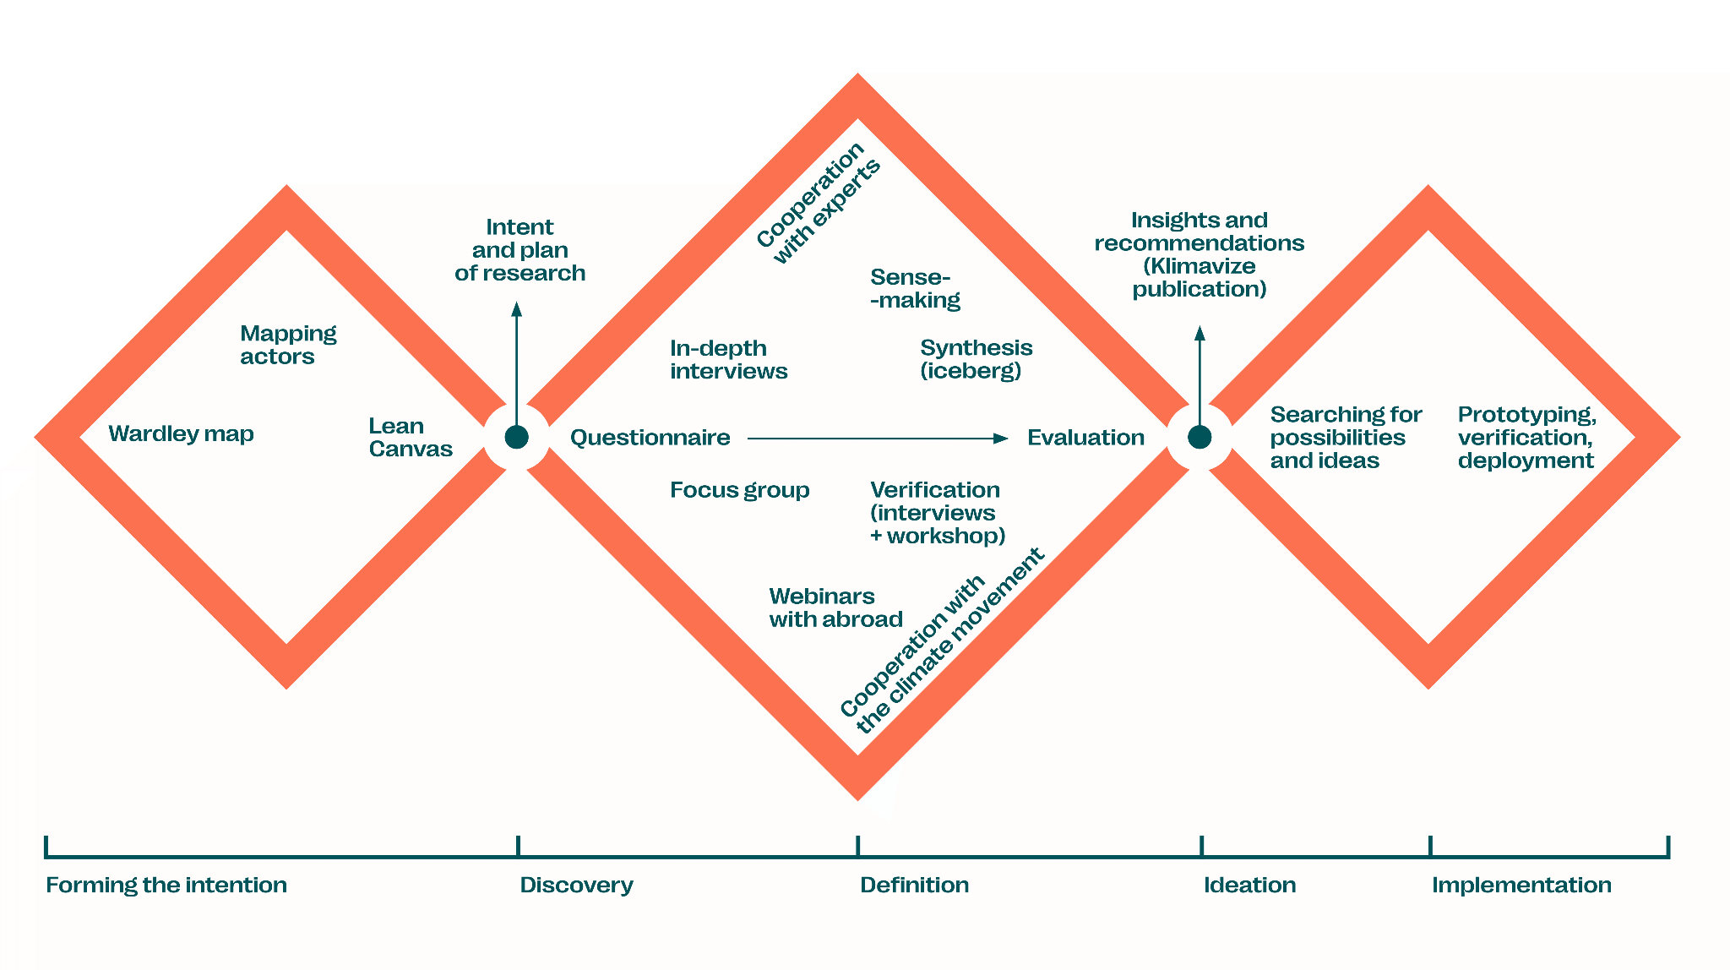
Notes:
So how did we approach the project?
We used the classic double/triple diamond
However the Klimavize project effectively addressed only the first and second diamonds Forming the intention - at first, we had to unite on what we wanted - what should be the outcomes of this? (not outputs!)
It was also necessary to form the team and get aligned with one another (designers × climate activists)
Methods we used
Wardley Maps: method from business strategy, we mapped the topic of “climate change” on two axes - evolution and how transparent it is that this topic is related to it - this helped us understand how broad the problem of climate change was and what topics we should focus on in the research - because we knew we didn’t want to focus just on climate change itself
Actor mapping: using these topics, we then mapped the people we could include in the research
Lean Canvas: helped us frame the project itself - how did we know we succeeded? What were the outcomes we wanted?
Then the second diamond - two lines: experts × the movement itself
Interviews - we had to be flexible and iterative. We had a script (a set part) and then a part which we adjusted for each participant
We also did not pick 20 people at the same time - we picked 5 and then carried on from there after analysing the 5 interviews
How did we do the analysis - using the iceberg model by Donella Meadows, from systems change
[překlik na další slide]
The movement itself: questionnaires mapping the topics that were important for the movement, focus groups on how they work with the strategies, webinars where we verificated if the form of the output (book) is OK
Then text-writing - a community job, the book had more authors than just the 6 of us
So what about the third diamond?

Slide 4
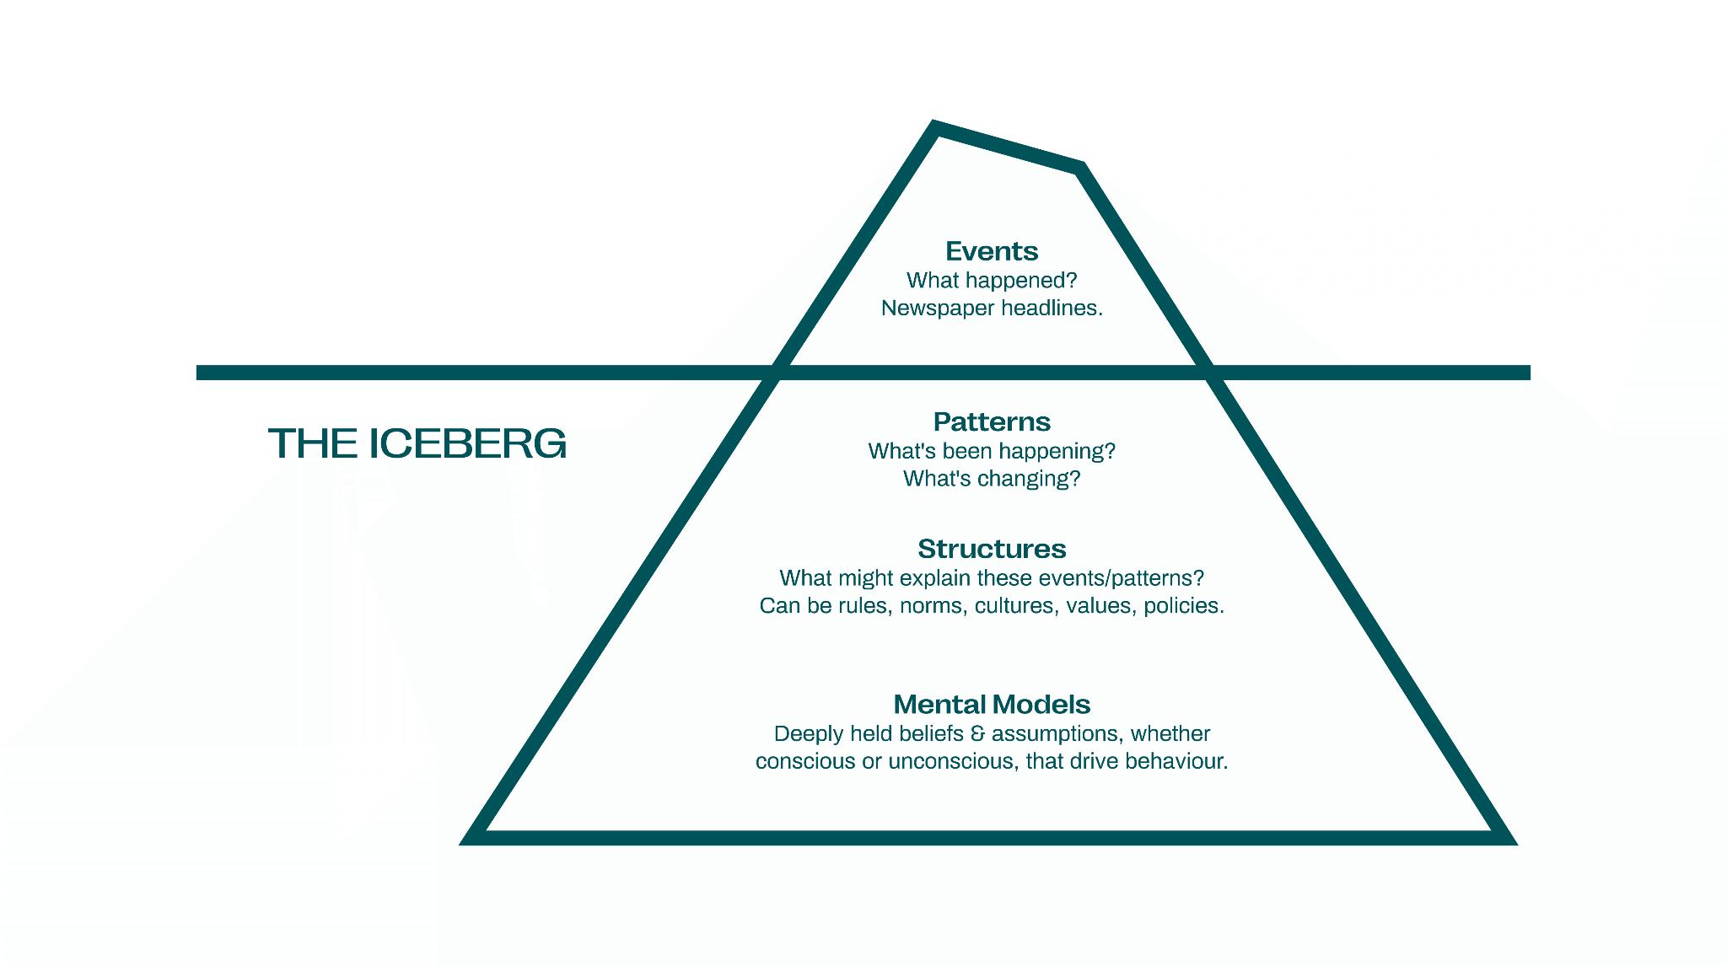
Notes:
The iceberg model: something that might be quite useful for your transition design projects
It asks you to connect events to patterns, structures, and mental models
By looking for these solutions which are “beyond the surface”, you can actually find spaces for systemic change
All of us did the data analysis together in workshop form
First - analysis of different topics, then their placement into the levels of the iceberg
It was crucial that we did this together in an interdisciplinary team
The designers knew the methodology, the climate activists knew the topic -> the analysis was made better by this

Slide 5
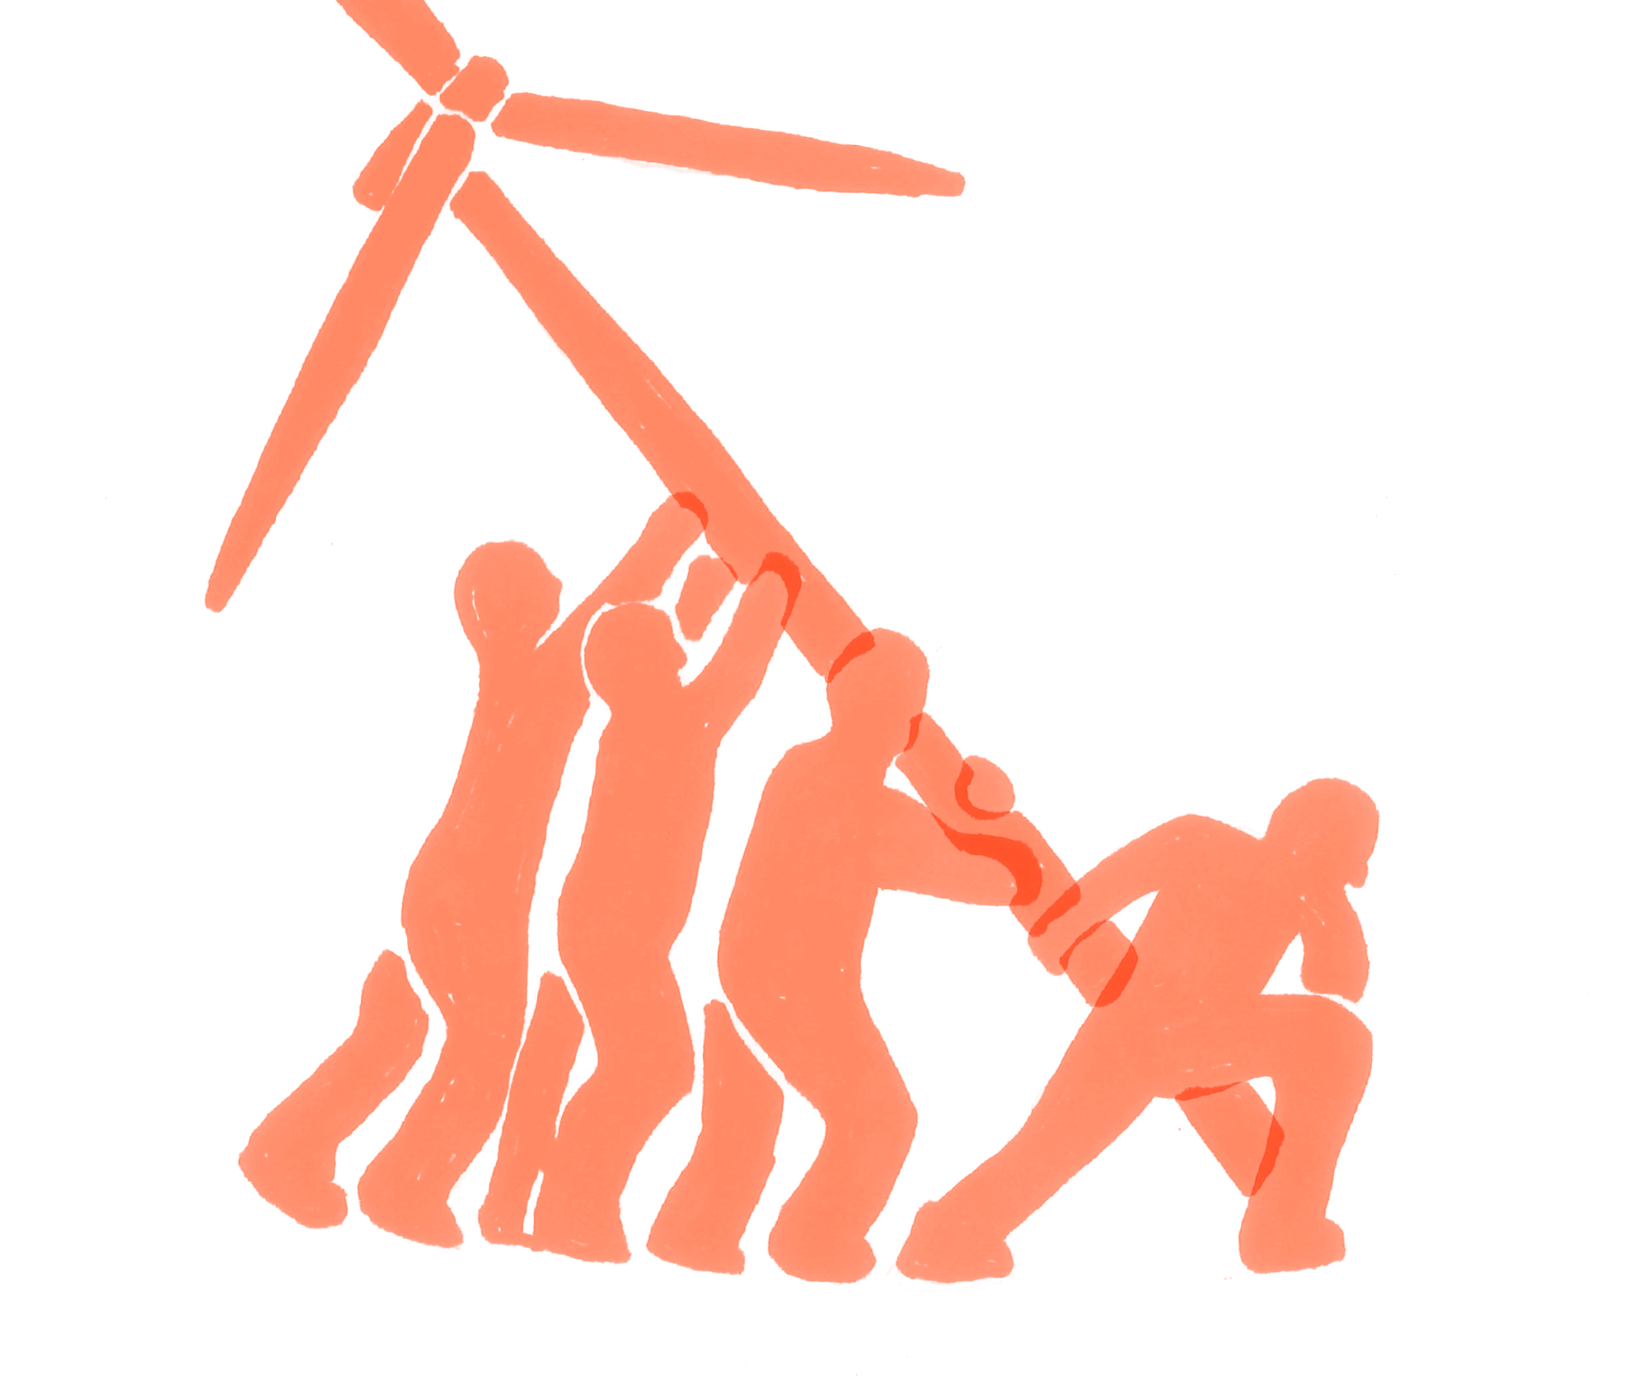
So where’s the transition potential?
Notes:
As I pointed out already - this entire project was about systems thinking which is very closely related to transition design

Slide 6
What’s next?
Facilitating workshops for organisations who want to use Klimavize
Toolbox of methods
Notes:
The third diamond - for us, this will be workshops with organisations who want to use Klimavize to shape their strategies
Our research has discovered opportunities and possible leverage points - things that will tip the entire iceberg
We are currently making a toolbox of methods (mostly design ones) that will be used during such workshops and possibly freely available to anyone who would like to use Klimavize
We are also using some of transition design methods there - they fit in perfectly with the topic we have been researching
The way I see it - it’s up to the movement to actually “design” the transition they would like to see
We as a group can help them and I see many exciting possibilities here
So maybe that’s also an interesting input - on how to do “collaborative” transition design

Slide 7
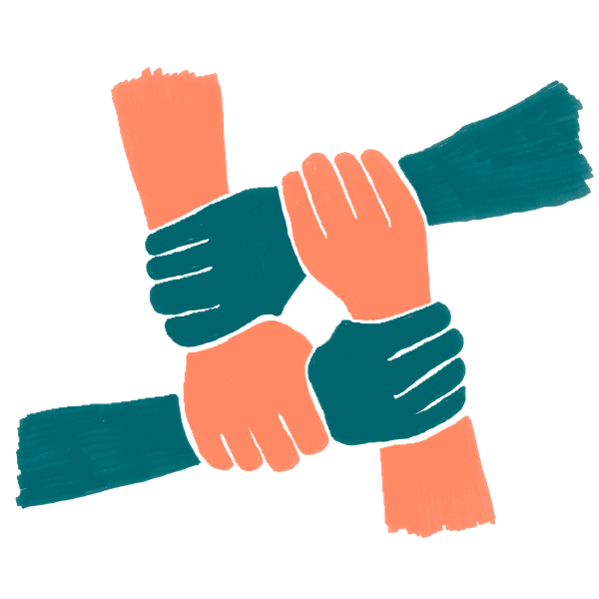
Notes:
I really think there are so many opportunities for transition design in climate and social movements
And we need them now more than ever
So if this feels like your thing - do not hesitate to contact friends/local groups you might know and think about how design or transition design could help them
In the beginning, I was a little bit sceptical how people from the climate movement would accept design methods and if it would find them useful
However it turns out that our toolkit and mindset can really be useful - at the end, the people from our collective really appreciated the design inputs
So let’s use these methods to help out because our skills are needed

Slide 8
Questions?

Slide 9
Thank you!
Tereza Navarová @terezanavarova
www.klimavize.cz
info@klimavize.cz

