Slide 1
Sustainability starts with teachers
Facilitating for eco-literacy and curriculum reform together with vocational teachers in Norway
This Photo by Unknown Author is licensed under CC BY-ND
Notes:
For the past two years I have been working with VET and TVET educators who want to increase their own competence in sustainable education. They face many challenges, most often from the structuring of their own teaching but also in the cultural norms present within upper secondary schools. For this talk I’ll look at some of the ways in which we work to shift individual mindsets, implement holistic sustainability agendas within schools, establish a new colleague of praxis and build resilience and changemaking capacities among secondary school teachers.

Slide 2
Vocational education and design: closer than you think
Practice based pedagogy
Production processes
Close alignment to the commerical field
Field of praxis seperate to traditional academic knowledge
Project-based learning
Notes:
Teachers when they arrive to my course are for the most part above averagely interested in sustainability.
Post this reform, many are struggling to see a way to teach sustainability that sticks. And a smaller number lack enough competancy in the field that their line managers have requested them to take the class.
The course itself is entirely autonomous, ansynchonous. The students are all adult learners, with a degree behind them already, and maybe a masters, they are all in full time work, and they are all in the process of integrating an entirely new subject curriculum. They are generally quite stressed.
In order to master their own learning jouney there is also a hidden curriculum, which gels with the department of educations goals. Increasing digital pedagogical competancy

Slide 3
Background
Norway has recently undergone a significant reform of the Education Act, with far reaching consequences for how sustainability is approached within the national curriculum. Updated in 2020, the first paragraph of the Act, which is binding for all compulsory schooling in Norway, as well as upper secondary vocational specific training, now includes the obligation that:
The pupils and apprentices must learn to think critically and act ethically and with environmental awareness. They have joint responsibility and the right to participate in society
This Photo by Unknown Author is licensed under CC BY
Notes:
Additionally, the education reform identifies three crosscutting transdisciplinary themes that must now be integrated in every subject. These are: sustainable development, diversity and participatory democracy, and identity formation and public health. Emphasis within the new national curriculum also leans heavily on critical and systems-based thinking, problem solving, deep learning and ethics.

Slide 4
How to put this into practice though?
While the overarching education law is very clear, these three crossdisciplinary themes present themselves quite different at a subject curriculum level.
It is up to each teacher to integrate them as he or she sees fit
This is problematic for several reasons
Notes:
Its fragmented, up to individual engagement to tackle what is by and large a systemic issue. Stunts at school are fine but teach both pupils and teachers that sustainability is something to be implemented ON TOP of their already existing workload. Pupils are not idiots, and they see contradictions where they are aparent (taking them to the coast to pick up plastic and then still having plastic cutlery in the school canteen)

Slide 5
The struggle to integrate sustainability is real…
Astrid Tonette Sinnes, & Ingerid Solrunsdatter Straume. (2017). Bærekraftig utvikling, tverrfaglighet og dybdelæring: fra big ideas til store spørsmål. Acta didactica Norge, 11(3).
Birgitte Bjønness, & Astrid Tonette Sinnes. (2019). Hva hemmer og fremmer arbeidet med Utdanning for Bærekraftig Utvikling i videregående skole? Acta didactica Norge, 13(2).
Offergaard. (2020). Tverrfaglig integrering av bærekraft som utfordring for yrkesfaglærerutdanninger. Scandinavian Journal of Vocations in Development, 5(1).
Knain, Ødegaard, M., Kvamme, O. A., & Sæther, E. (2021). Bærekraft i lærerutdanningen – å gi mening til frustrasjon og kompleksitet. Acta Didactica Norden, 15(3).
Frode Skarstein, & Tuula H. Skarstein. (2020). Skalaproblematikk i utdanning for bærekraftig utvikling. Norsk pedagogisk tidskrift, 3, 313–326.
Notes:
Despite Miljølærer historie stretching back to 1974, and there is a long tradition of engaging with sustainability principles in the natural and social sciences, this new requirement for multisubject teaching, deep learning and critical thinking is experienced as problematic for many teachers, Vocational or not.
These three themes relate to actual wicked problems in society in general, so they don’t really have clear answers, or even agreed upon ways of approaching them.

Slide 6
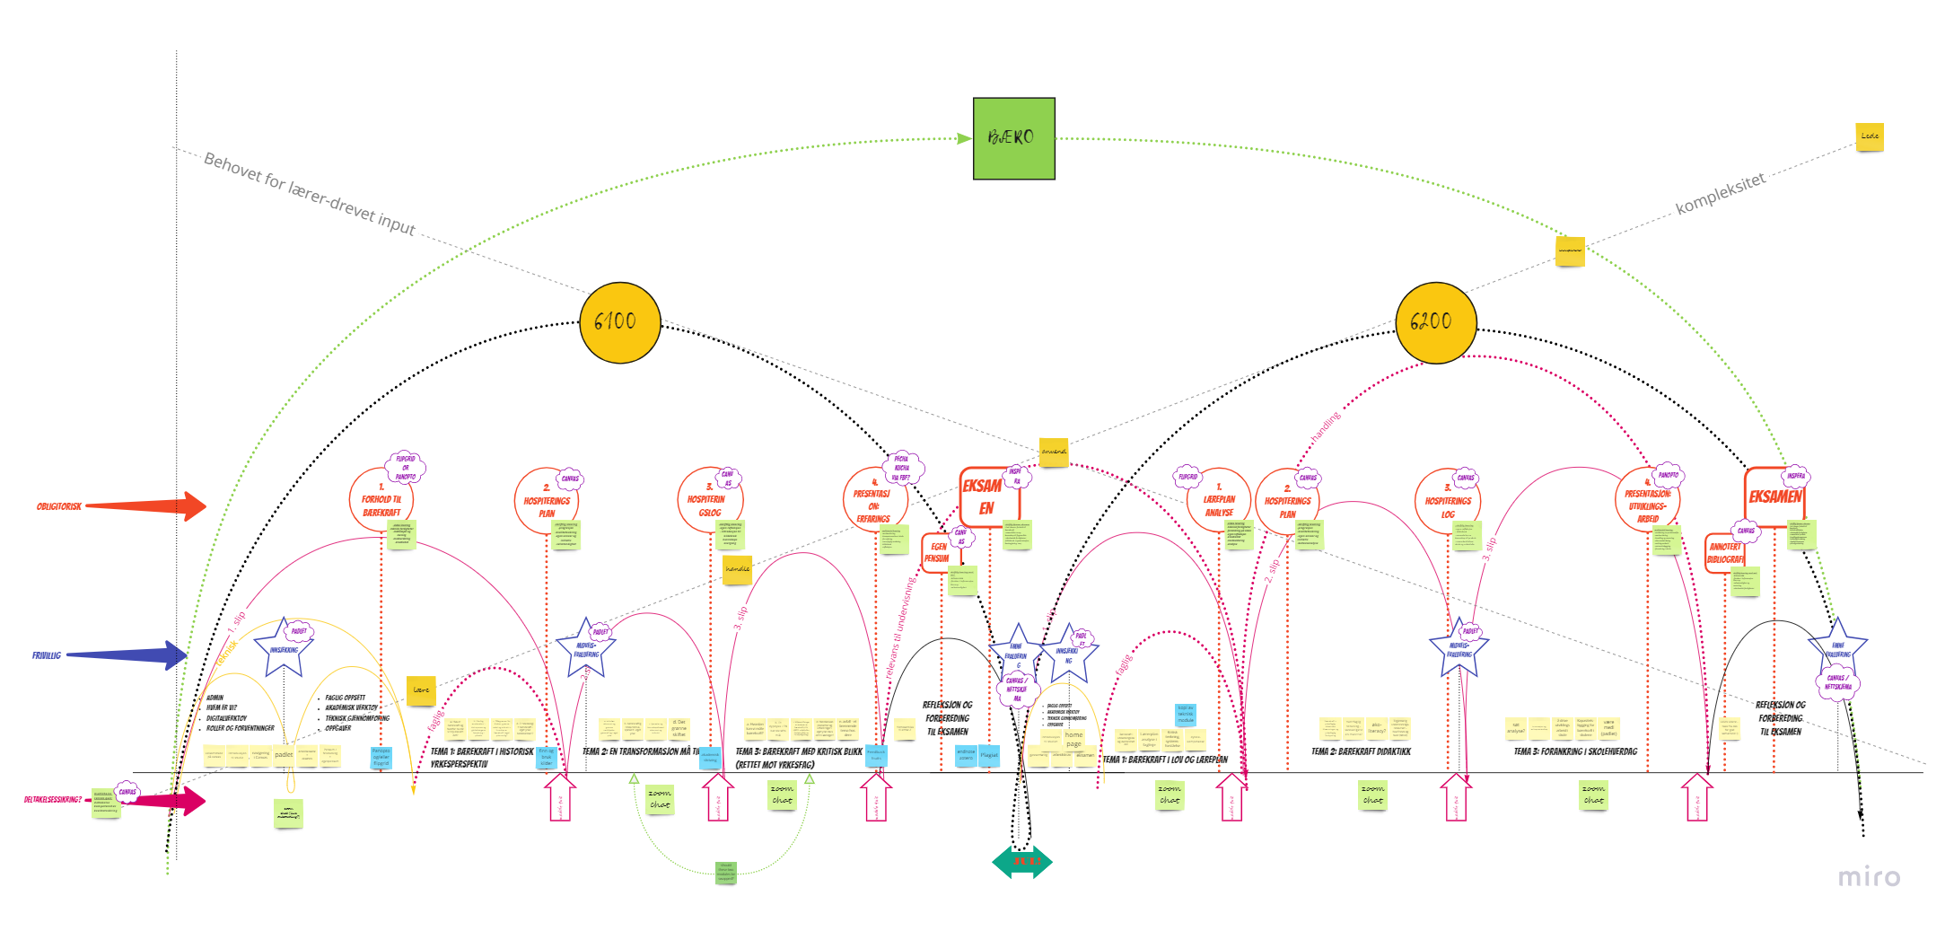
Notes:
Learning Arch Design methodology from kaospilot school Aarhus Denmark
Designing online learning environments.
Facilitating for autonomous learning journeys.
Setting space, allowing for experiences to unfold, holding that space, and landing or reflecting on how that learning is shaped. Most of all this entails meeting the students where they are, understanding that paradaimatic curriculum change is a process, as is sustainability, and that we are all here to learn from each other.

Slide 7
A bit of light reading relating to transforming education
Sterling. (2001). Sustainable education : re-visioning learning and change: Bd. no. 6. Green Books for the Schumacher Society.
Jickling, & Sterling, S. (2017). Post-Sustainability and Environmental Education: Remaking Education for the Future. Springer International Publishing AG; Cham: Springer International Publishing AG
Davelaar. (2021). Transformation for sustainability: a deep leverage points approach. Sustainability science, 16(3), 727–747.
O’Brien. (2018). Is the 1.5°C target possible? Exploring the three spheres of transformation. Current opinion in environmental sustainability, 31, 153–160.
Szekely. (2019). A Political-Economy Orientation in TVET’s Project-Based Learning Methodologies for Sustainable Development. I Szekely, Handbook of Vocational Education and Training (s. 413–429). Springer International Publishing.

Slide 8
What makes it work:
Meeting students where they are
Student centric learning and autonomy
Establishing a community of practice
Peer evaulation and workplace sharing
Moving through the LAD learning spheres
Learn, act, adapt, inspire, lead
Keeping it close to the field of practice
Building relationships for apprenticships that will last
Honesty and an open mind
I don’t have all, or even really any of the answers
This Photo by Unknown Author is licensed under CC BY-NC

