Slide 1
Technology for a better society - sustainability at sintef
Amela Karahasanović - SINTEF
Transition – Design – Education, Prague 6th of May 2022

Slide 2
Agenda
How we work towards sustainability at SINTEF
Some examples
How we used transition design for development of sustainable transport in rural areas
Lessons learned

Slide 3
SINTEF - Technology for a better society

Slide 4
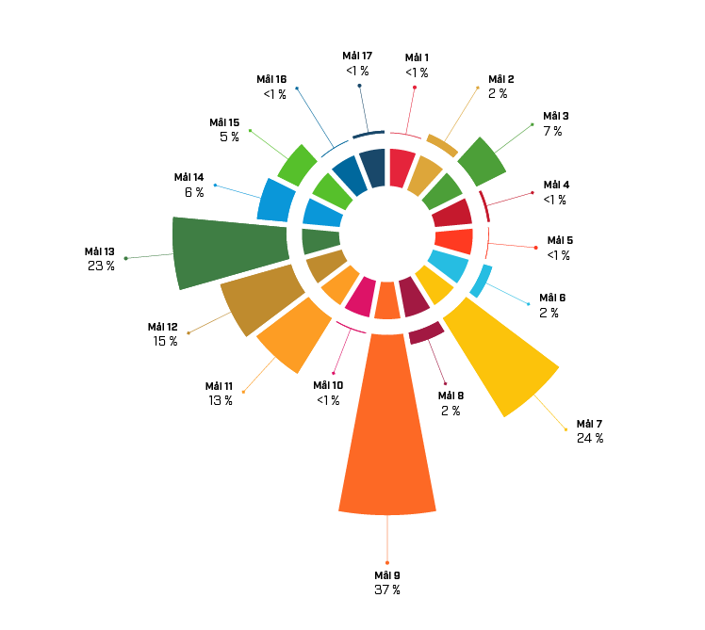
Project portfolio
1. No poverty
2. Zero hunger
3. Good health and weel-being
4. Quality education
5. Geender equality
6. Clean Water and Sanitation
7. Affordable and Clean Energy
8. Decent Work and Economic Growth
9. Industry, Innovation and Infrastructure
10. Reduced Inequality
11. Sustainable Cities and Communities
12. Responsible Consumption and Production
13. Climate Action
14. Life Below Water
15. Life on Land
16. Peace and Justice Strong Institutions
17. Partnerships to achieve the Goal
Gross turnover per Sustainable Development Goal in 2020

Slide 5
Project examples

Slide 6
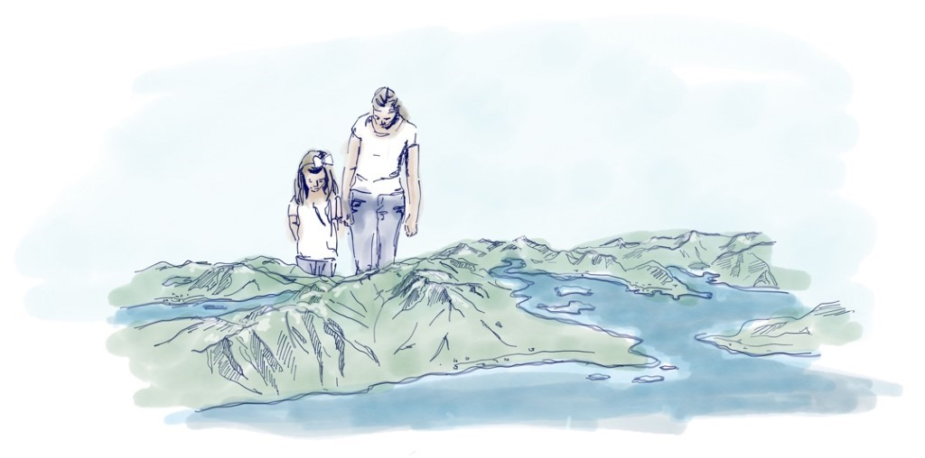
IPN GAIA Vesterålen We build sustainable municipalities
Partners: Lofotr Næringsdrift, Deadline Media,
VIKT, Nordlandsforskning
Kredit: Vilde Odmundson, Deadline Media
Gaia Vesterålen is a citizen-driven environmental project, with participants from all parts of society who want to steer towards defined and ambitious climate goals by learning from history to inform the future using digital technology.
Gaia Vesterålen will collect and visualize data important for the the region – like settlement, climate change, garbage, education. This information will be projected (projection mapping) on the 3D model in combination with AR and VR experiences, as well as a history-gathering unit for the citizen to contribute.

Slide 7
Example SESAR Innovation
Open Call
Development of a Decision support tool for Air Traffic Controllers
PJ28 IAO Integrated Airport Management Very Large scale Demonstration (VLD)
Improving Runway Throughput - Hamburg
TRL 1-2 (Exploratory research) TRL 3-6 (Industrial research) TRL 7-8 (VLD/Digital sky demonstrators)
PJ 02 EARTH Enhanced RWY Throughput
Methods and software for dynamic, coordinated arrival, departure, and surface management at Arlanda
SESAR 2020 Demonstration Membership
SESAR 1 Exploratory Research OPEN CALL
SESAR 2020 Industrial Research Membership

Slide 8
Sustainable transport in rural norway

Slide 9
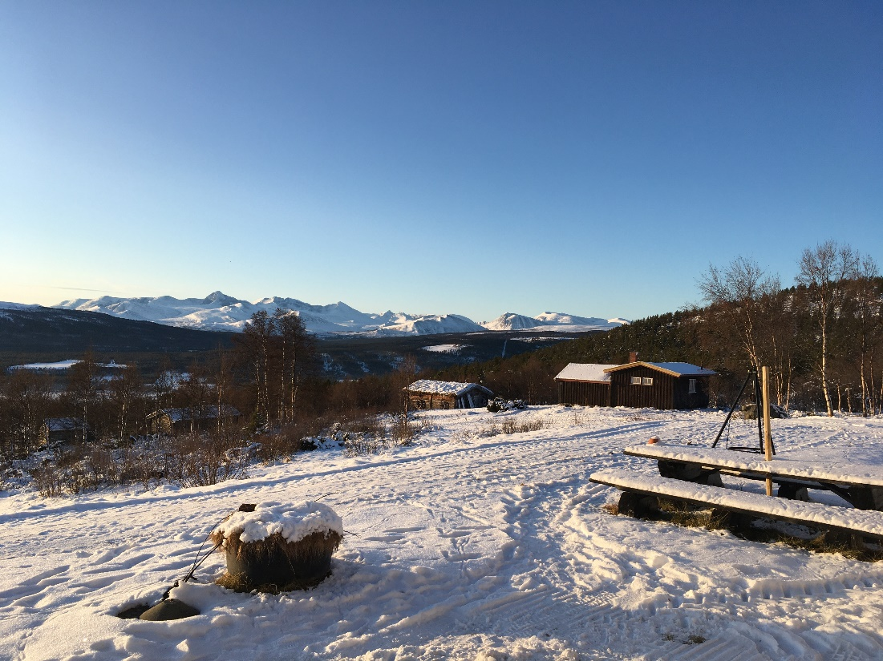
Innlandet County
Area 52 072.44 km²
Population 371 385 (4th quarter 2019)
Population density 7.1 inhabitants per km²
^{Wikipedia.org}
© A.Karahasanović
CC by NordNordWest

Slide 10
Smart transport in rural areas
Develop a MaaS service specifically tailored for sparsely populated rural areas
A service offering passengers the transport that suits their needs by combining transport services from different providers through unique platform
Create a holistic system for transport planning that dynamically coordinates the transport of people and goods to make the most of transport resources
Transport of patients, blood samples, food, elderly, school children, public transport in county

Slide 11
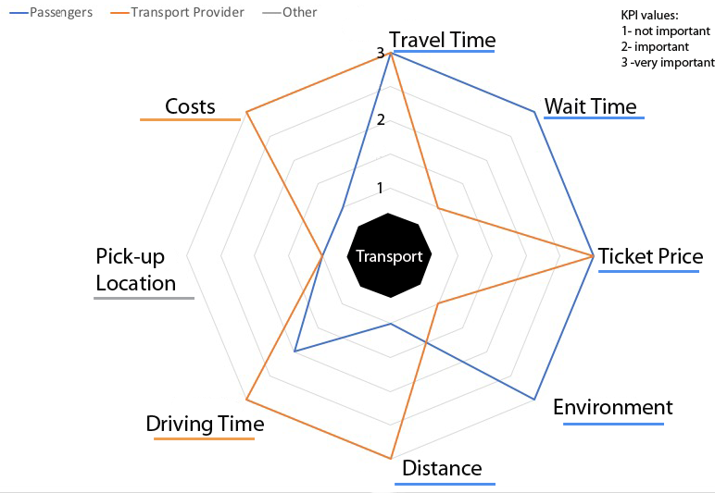
Transition design in practice
Why transition design
Approach to lead transitions towards more sustainable futures
Calls for more holistic approach
Takes a long-term perspective
Rethinks solution beyond financial and commercial interests; specially relevant in rural areas
What we missed
How to get from high level sustainable goals to design prototypes?
We proposed using KPIs in all phases and used it in Reframing the present and future and Designing intervention
Waiting and observing – in the follow-up pilot projects (higher TRL)

Slide 12
Planning tool for MaaS operators
The goal to engage citizens in more environmental behavior generated some design ides
Presenting impact of a proposed solution on KPIs
KPIs as an input to the tool
“So intuitive tool for us. This is 100 steps forward”
“We really have to cut CO2 emission by 50% until 2030 and it is … like tomorrow. Let’s introduce free public transport”

Slide 13
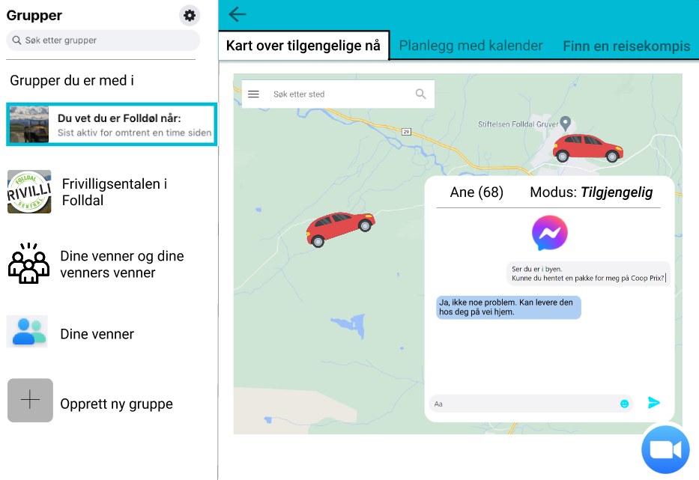
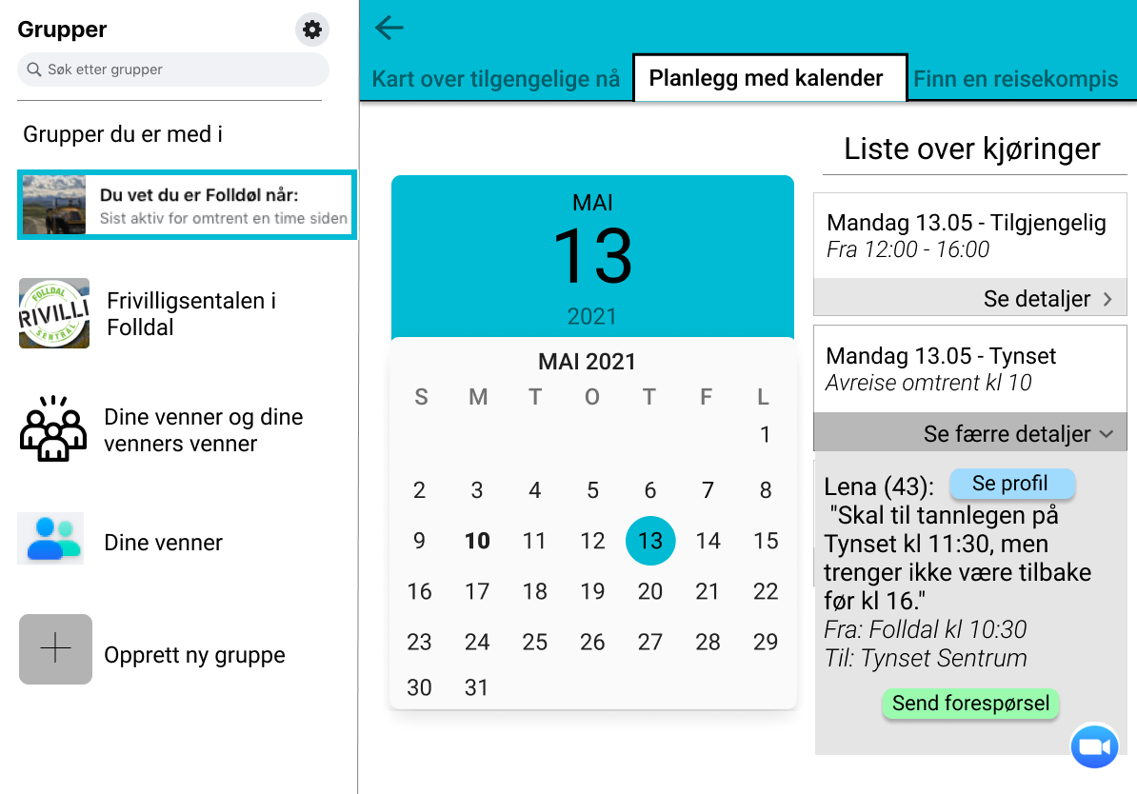
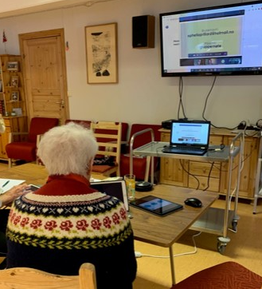
«this small keystroke ca make that they [elderly] become engaged and come out of the house»
[are there any problems here]
"No, I just see the opportunities"
Prillard, O. A. (2021). The Design and Creation of an ICT Transportation Management Service to Increase Mobility for Older Adult in Rural Areas. MSc Thesis in Engineering and ICT. Trondheim, NTNU.

Slide 14
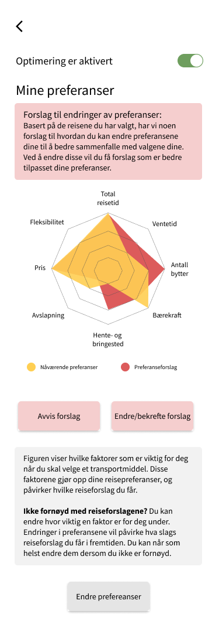
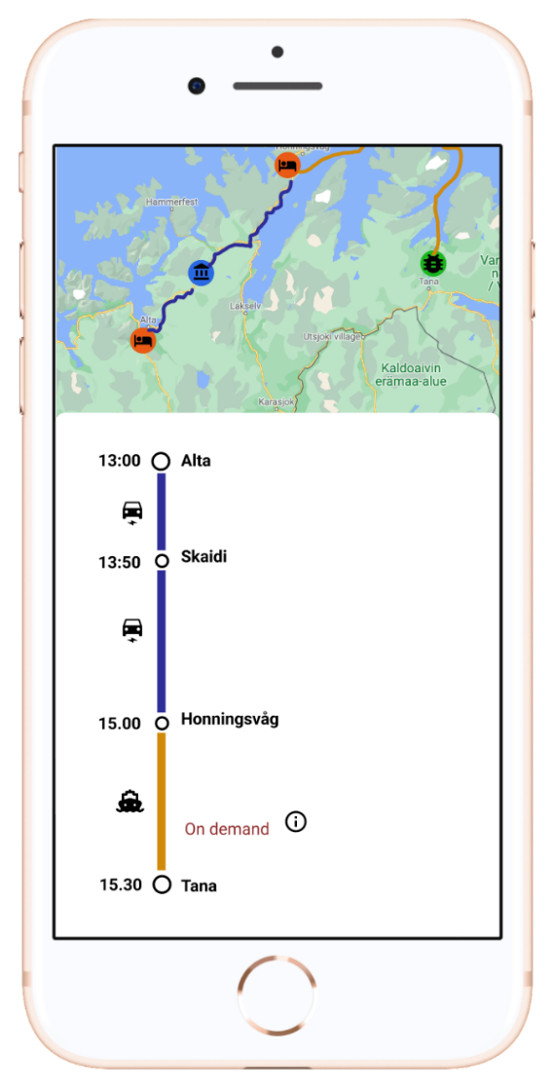
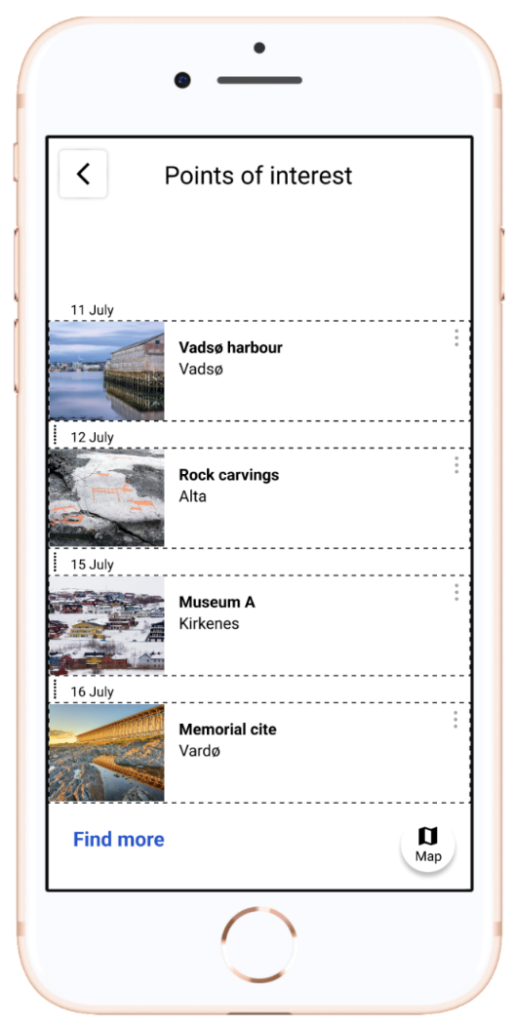
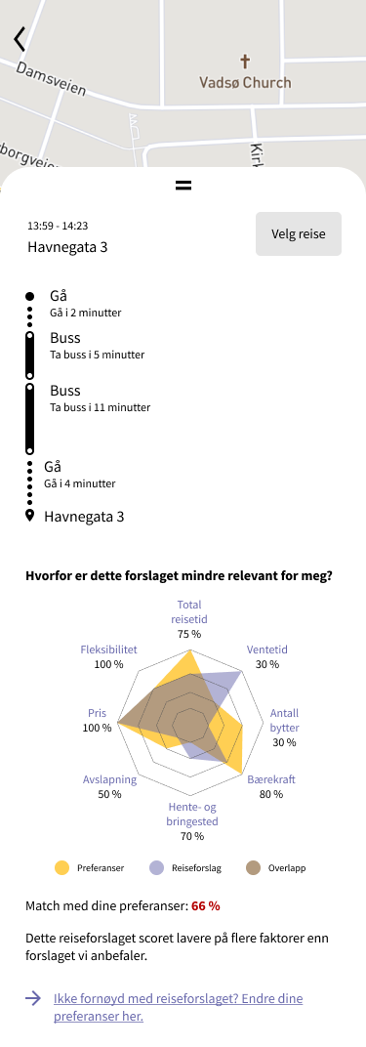
Lund, S. H. and M. L. Johansson (2022). User-centred design of optimisation based systems for rural mobility, MSc thesis, IFI, UiO
Österberg, L. E. (2022). The role of prototypes in design of MaaS services for rural areas, MSc thesis, IFI, UiO

Slide 15
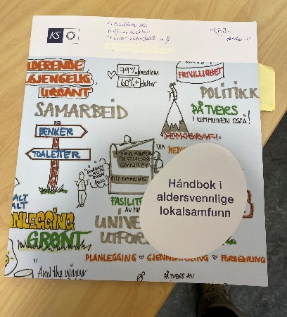
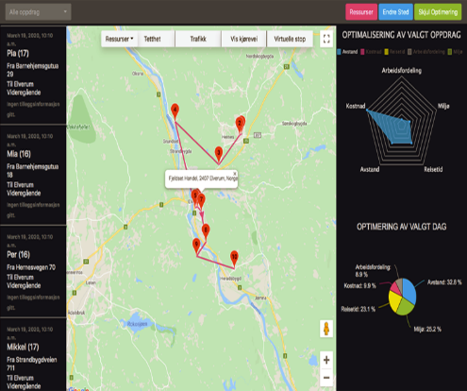
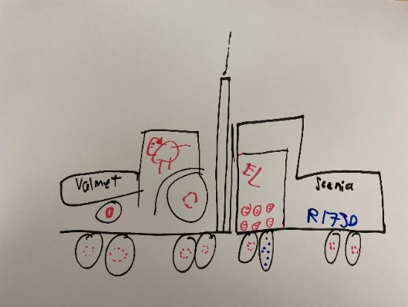
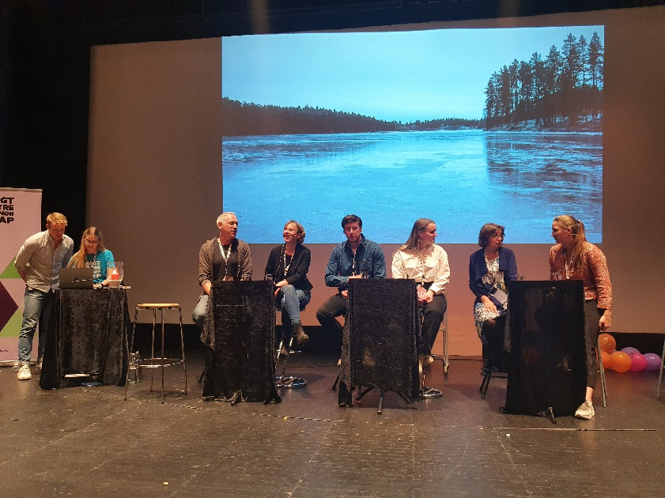
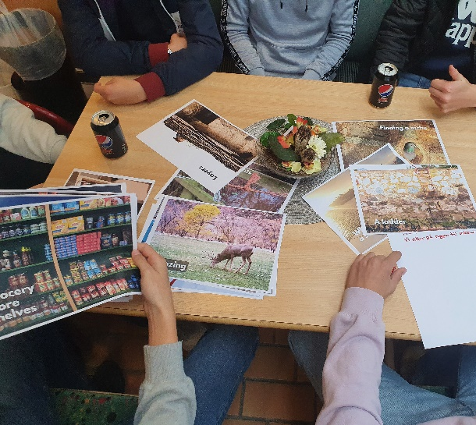
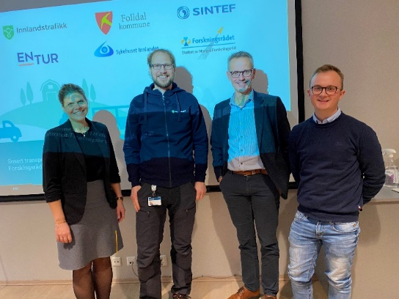
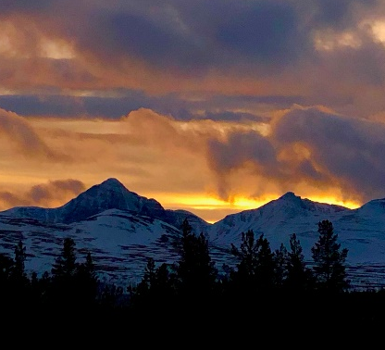
Impact
18% reduction of CO2 footprint
59% reduction of cost
10 minutes longer travel time

Slide 16
Lessons learned

Slide 17
What have we learned
Transition design (focus of envisioning future) initiated radically new ideas and engagement among citizens and politicians; it enabled collective and participatory imagination, awareness of close the future is
free public transport in municipality to achieve 50% reduction of CO2 footprint in the municipality
Difficult to explain that transitions take time
citizens were expecting driving busses and drones at the end of the project while we were developing the algorithms; good support from politicians was important
You cannot solve everything in one project
You have to actively use SDGs as a tool for strategic planning in your organization
Building a good network, partners, stakeholders and ecology of projects over longer time

Slide 18
What have we learned cont.
Transition design (monitoring phase) helps moving from green-washing to real transitions and changing the attitudes
Use of KPIs was useful for establishing the common ground and helped keeping the focus on sustainability
Media might help you
What’s next
New EU and national projects already started
Further development of the concepts, tools and methods

Slide 19
THANK you for your attention!!! Questions? Comments? Contact: amela@sintef.no

